Slide 1

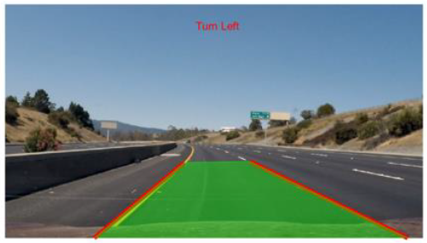
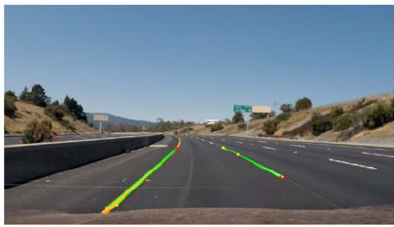
Project Title: Lane Detection For Autonomous Vehicles
Team members : D.Shreyas , Shobith bankapur, Chandu.S ,Prajwal T P
School of Electronics and Communication
Senior Design Project-2023-24
Problem statement
Proposed Methodology
Results and inferences
Developing a image processing solution for road lane detection, addressing challenges like varying conditions crucial for autonomous vehicles and road safety.
PRE-PROCESSING OF IMAGE
1.Initializing the Code.
2.Initializing the loop to take frames one by one.
3.Masking the image for White and Yellow Colour.
Objectives
Implementation of Edge Detection algorithms:
Canny Edge Detection
Hough Transform
ROI EXTRACTION
1.Deciding ROI Points and Extracting ROI.
Literature survey
Lane detection for autonomous vehicles involves crucial research on edge detection, employing Canny and Hough transform. Studies address urban challenges [1], diverse conditions [3], curved lanes [9], and hybrid models with deep learning [2]. Real-time implementation [4], adaptive strategies [5], and comparative analyses [8] inform algorithm selection. Adverse weather challenges are tackled using sensor fusion [6]. These studies collectively explore edge detection, emphasizing the integration of classical and contemporary methods for effective lane detection [7].
EDGE DETECTION
1.Neglecting Closed Edges in Smaller Areas.
Design and Optimization details
HOUGH TRANSFORM
1.Extracting Straight Lines From the Image.
Input Video
ROI Segmentation
Edge Detection using Canny Filter
Hough Transform
Detected Lane
Contributions
TURN PREDICTION AND PLOTTING ON THE IMAGE
Conclusions
lane detection using Canny and Hough transform plays a crucial role in enabling autonomous vehicles to navigate safely and accurately on various roads and environments. Its contributions lie in its robustness, real-time performance, simplicity, adaptability, and foundation for further advancements in lane detection technology.
In conclusion, our autonomous vehicle lane detection system, powered by Canny operators plus the Hough transform,
effectively combines edge enhancement, multi-stage refinement, and accurate line identification. This synergistic approach minimizes false positives, ensuring a reliable solution for maintaining lane position and enabling safe navigation in diverse conditions
Semester: VII Under the guidance of:
Prof.Rohit Kalyani

